Slide 1
Early Greek Science and Philosophy

Slide 2
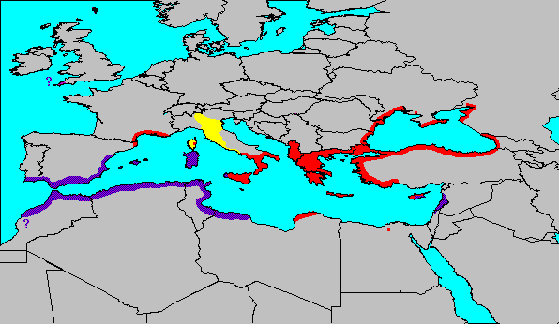
Early Greece
Greece and Greek Colonies
Rome and Roman Colonies
Phoenicia, Carthage and Punic Colonies

Slide 3
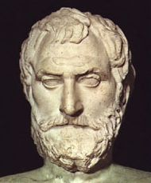
Thales of Miletus 625 BC
First Philosopher
Used organized, formal arguments
First Mathematician
Used formal proof method
Learned from Mesopotamians and Egyptians (who kept records only)
First Scientist
“All events, even extraordinary ones, can be explained in natural terms which can be understood by humans.”
Asked why things happened and then tried to find a rational answer
“What is fundamental and does not change?”
Assumed that an order existed
Underlying principle or basic material is called arché in Greek

Slide 4
"In its early days philosophy included science – which became known as 'natural philosophy'. Thales' thinking was scientific because it could provide evidence for its conclusions. And it was philosophy because it used reason to reach these conclusions."
– Strathern, Paul, Mendeleyev's Dream, New York: Berkley Books, 2000, p.11.

Slide 5
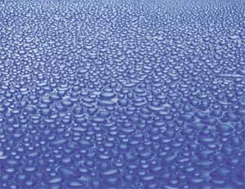
Thales
The fundamental matter?
Water (one materialist)
Fossils on hilltop
Presence in so many things
Different forms (ice, liquid, steam)

Slide 6
"We know from anecdotal evidence that Thales arrived at his theory [that water is the fundamental material] after seeing some seashell fossils high above the contemporary sea level. But his speculations probably went deeper than this. He must have seen the mist rising from the Anatolian hills to become clouds, and have observed the rain falling from clouds in storms out over the Aegean. Land becoming damp air, which in turn became water. Just a couple of miles north of Miletus, a large river meanders over the wide plain to the sea. (This is in fact the ancient River Meander, from which our word derives.) Thales would have observed the river slowly silting up: the water becoming muddy earth. He would have visited the springs on the nearby hillside: the earth becoming water again. It takes little imagination now to see how Thales conceived of the idea all is water."
– Strathern, Paul, Mendeleyev's Dream, New York: Berkley Books, 2000, p.12.

Slide 7
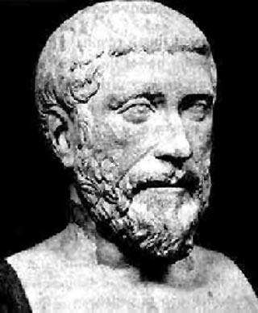
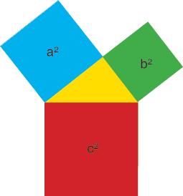
Pythagoras 580-500 BC
Invented mathematical notation
Developed system to express equations
Established quantitative calculations
Believed geometry and math could describe all truth and beauty
Truth is described by small whole numbers
Symmetry of the "perfect" body
Example today: Quantum chemistry
Developed a school and "ideal" society
Key geometric relationships
Pythagorean law
Golden mean
Principles of music

Slide 8
“The Golden Mean defines the proportions of the Parthenon, the shape of playing cards and credit cards, and the proportions of the General Assembly Building at the United Nations in New York. The horizontal member of most Christian crosses separates the vertical member by just about the same ratio: the length above the crosspiece is 61.8% of the length below it. The Golden Mean also appears throughout nature – in flower patterns, the leaves of an artichoke, and the leaf stubs on a palm tree. It is also the ratio of the length of the human body above the navel to its length below the navel (in normally proportioned people, that is). The length of each successive bone in our fingers, from tip to hand, also bears this ratio.”
– Peter L. Bernstein, Against the Gods, 1996, XXVI

Slide 9
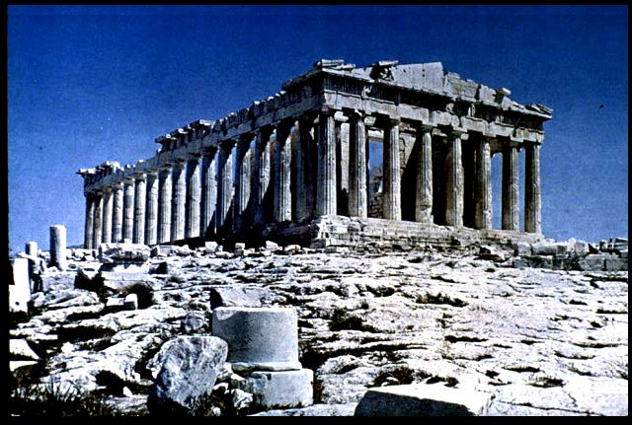
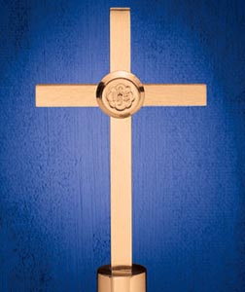
Golden Mean
Parthenon
Latin Cross

Slide 10
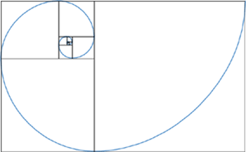
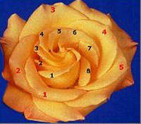
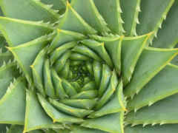
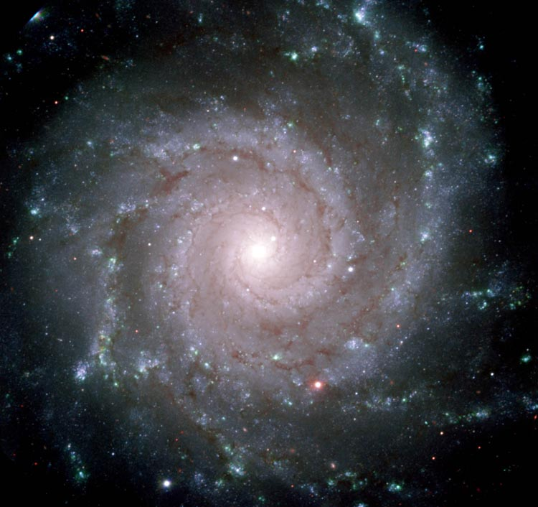
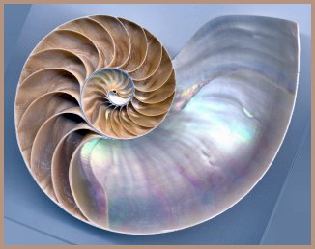
Golden Spiral

Slide 11
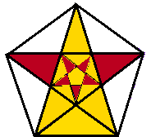
Pythagoras
Golden Triangle
Isosceles with 72 and 36 degree angles
Used to construct the Golden Spiral
Dodecahedron forms a 5 pointed star made of Golden Triangles
Symbol of the Pythagoreans

Slide 12
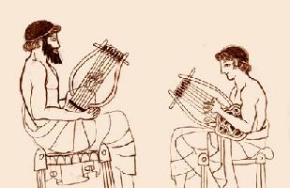
Pythagoras
Music rules discovered and quantified
Hammers had different tones according to weight
String length relationships (octaves, fifths, etc.)
Principle of harmonic vibration
Music's relationship to mathematics became basis of the study of nature
Music applied to medicine and astronomy
Good health resulted from harmony in the body
Motions of the planets were harmonic multiples

Slide 13
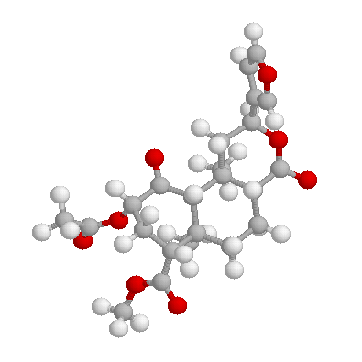
Other Pre-Socratics
Heraclitus
"No man steps into the same river twice"
Two worlds
Material = changing
Spiritual = unchanging
Xeno
Motion is not possible (1/2 way)
Democritus
Atomic Theory
Action of atoms determines all events
Solves the Xeno problem
Wrote over 70 books
Plato wanted to burn them all

Slide 14
Creativity
“The psychological conditions which make a society or an epoch creative and consistently original have been little studied, but it seems likely that social conditions analogous to those seen in individual creativity are important. Freedom of expression and movement, lack of fear of dissent and contradiction, a willingness to break with custom, a spirit of play as well as of dedication to work, purpose on a grand scale; these are some of the attributes which a creative social entity, whether vast or tiny, can be expected to have.”
— Frank Barron, Institute of Personality Assessment and Research, University of California, Berkeley

Slide 15
Thank You

Slide 16
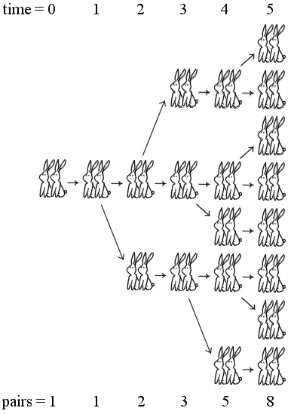
Fibonacci Series:
Rabbit Breeding

Slide 17
“While studying the of how many rabbits will be born from an original pair of rabbits, assuming that every month each pair produces another pair and that rabbits begin to breed when they are two months old. After the process got started, the total number of pairs of rabbits at the end of each month would be as follows: 1, 2, 3, 5, 8, 13, 21, 55, 89, 144, 233. Each successive number is the sum of the two preceding numbers. The Fibonacci series is a lot more than a source of amusement. Divide any of the Fibonacci numbers by the next higher number [and] the sequence of ratios will converge to 0.618. Dividing a number by its previous number will converge to 1.618. The Greeks knew this proportion and called it the ‘Golden Mean’.
– Peter L. Bernstein, Against the Gods, 1996, XXVI

Slide 18
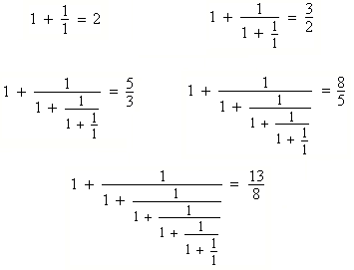
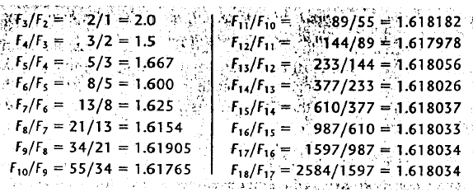
Fibonacci Numbers

Slide 19
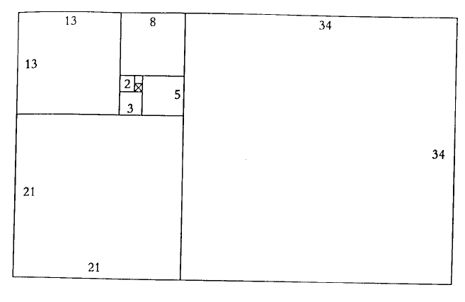
Pythagoras Golden Mean, Rectangles and Triangles

Slide 20
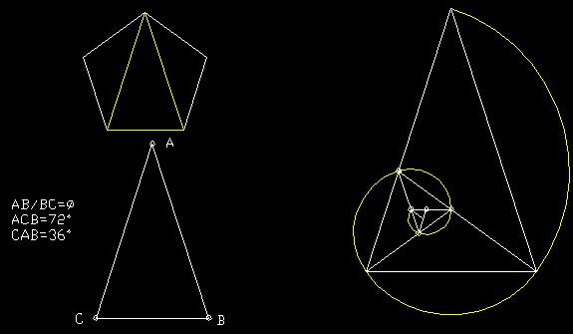
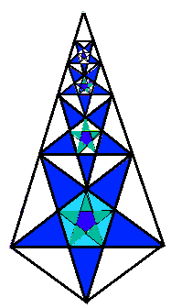
Pythagoras Golden Mean, Rectangles and Triangles

Slide 21
“The familiar-looking spiral [with areas based on the Fibonacci series] appears in the shape of certain galaxies, in a ram’s horn, in many seashells, and in the coil of the ocean waves that surfers ride. The structure maintains its form without change as it is made larger and larger and regardless of the size of the initial square with which the process is launches: form is independent of growth. The journalist William Hoffer has remarked, ‘The great golden spiral seems to be nature’s way of building quantity without sacrificing quality.’”
– Peter L. Bernstein, Against the Gods, 1996, XXVIII

